Slide 1
Java Course
Welcome to the
Module 1 – Day 1

Slide 2
Contents of the module
Introduction to programming
Basic programming concepts
Variables and Data Types
Conditionals
Loops
Control Structures
Introduction to algorithms

Slide 3

Fuad Mahmudov
Professional Background
5+ years as a Java developer
Built enterprise and web applications
Experience in teaching and mentoring beginners
About Me
https://www.linkedin.com/in/fuad-mahmudov/

Slide 4
What about you ?
Name
Background
What brings you to Java Module 1?
What do you expect from this course?

Slide 5
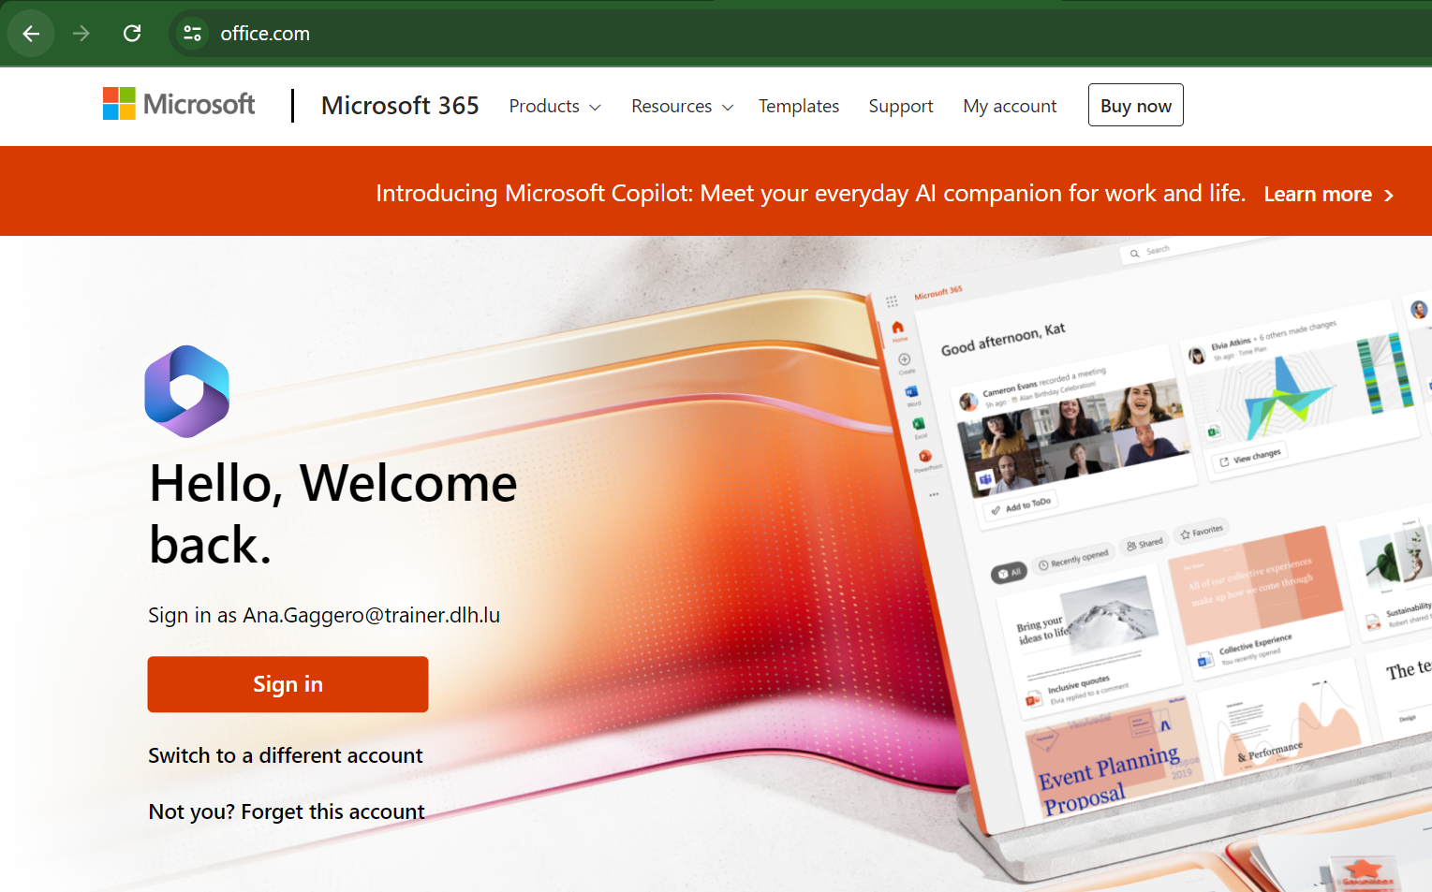
Log into the local PC and to Microsoft Teams
Open Google Chrome and type: office.com
Step 1: Click on “Sign in”
You should have received
your password by email.

Slide 6
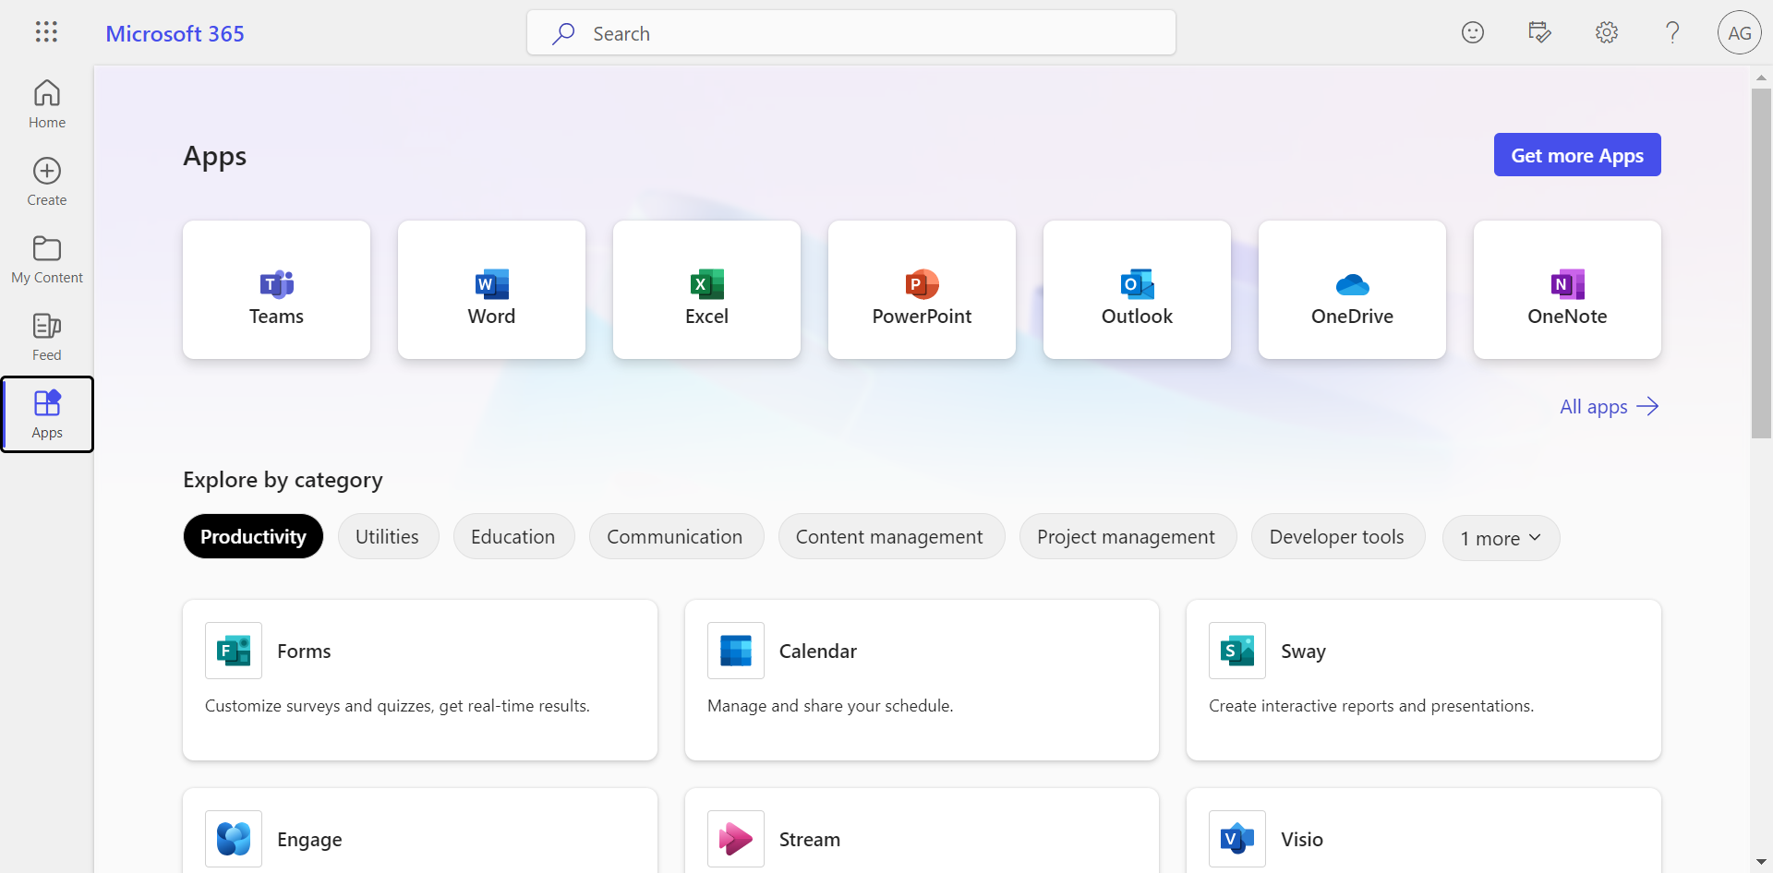
Log into the local PC and to Microsoft Teams
Step 2: Click on “Teams”
1
2

Slide 7
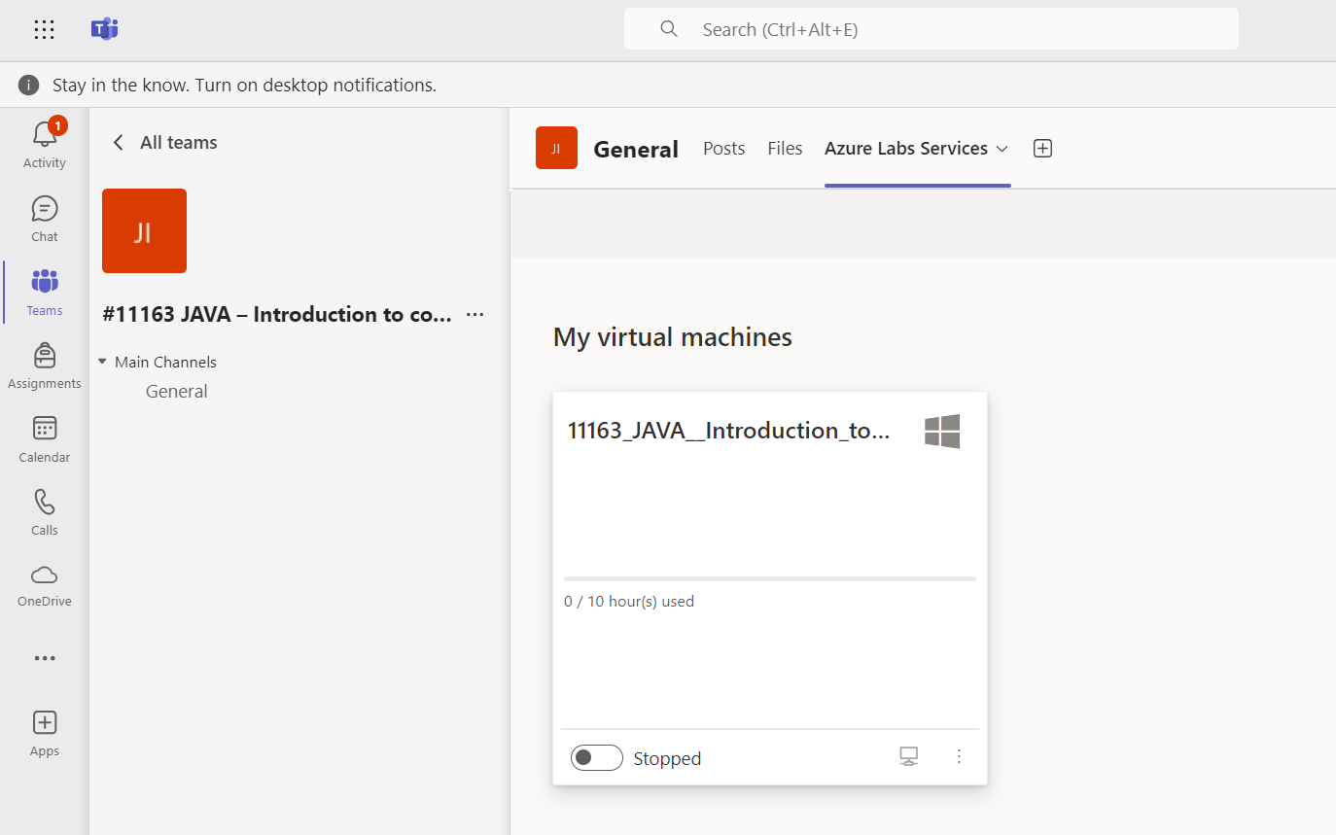
Log into the virtual machine
Step 1
Step 2
Step 3
The virtual machine will be already on. If not, turn it on, it can take up to 5 minutes to start.

Slide 8
Log into the virtual machine
Username: student
Password: StudentDLH!

Slide 9
Project Students
Building a program that gathers information from students and validates it.
Student Registration
Data Validation

Slide 10
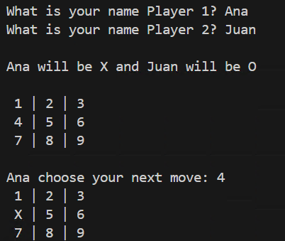
Project Tic Tac Toe
A program that allows two players to play Tic Tac Toe against each other

Slide 11
Computational Thinking
Problem-solving approach that helps you to think logically and solve problems effectively.

Slide 12
Computational Thinking
Decomposition:
Breaking down a complex problem into smaller, more manageable sub-problems or tasks.

Slide 13
Computational Thinking
Pattern Recognition:
Identifying recurring patterns or similarities in different problems to develop generic solutions.

Slide 14
Computational Thinking
Abstraction:
Focusing on essential details while ignoring irrelevant information to simplify the problem.

Slide 15
Computational Thinking
Evaluation and Optimization:
Evaluate the efficiency and effectiveness of solutions and refining them for better performance.

Slide 16
Algorithm
An Algorithm is an ordered series of steps that leads to the achievement of a goal or the solution to a problem.

Slide 17
Algorithm
step 1
step 2
[...]
GOAL

Slide 18
Computational Thinking
It is not limited to computer science but can be applied to various disciplines and real-world challenges.

Slide 19
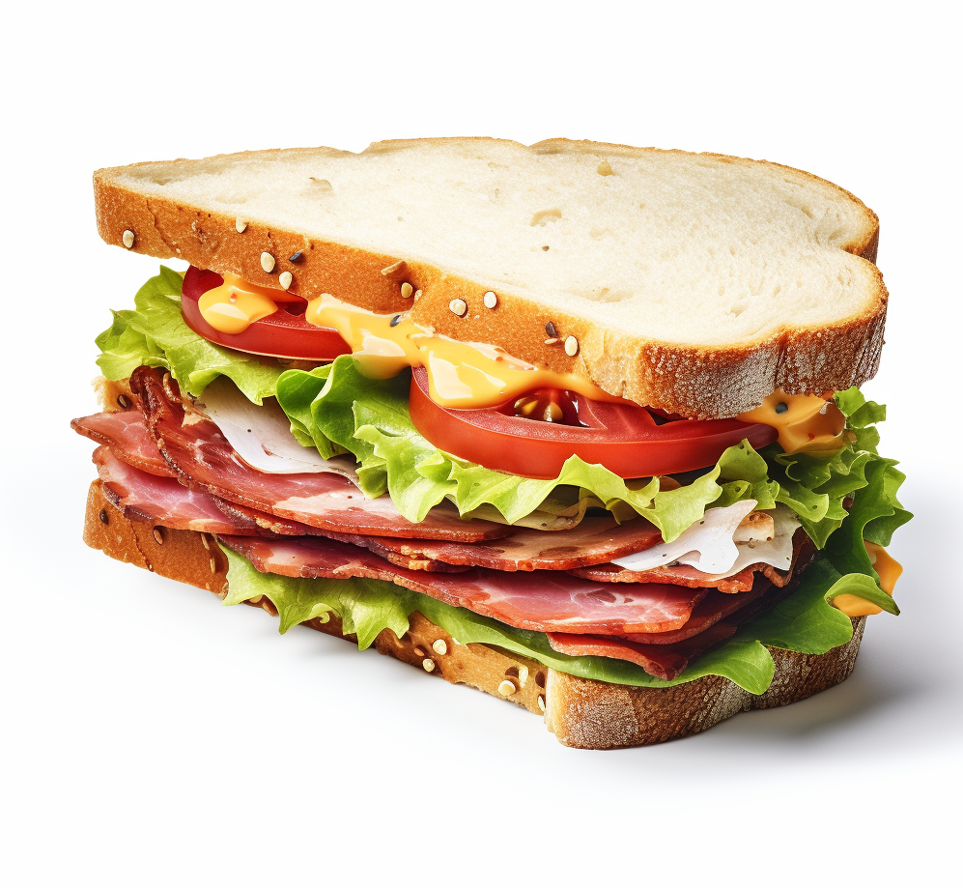
Computational Thinking
Make your sandwich
Decompose
step by step

Slide 20
Computational Thinking
Prepare the ingredients
Assemble the ingredients
Plate it
Concept: Decomposition and Abstration

Slide 21
Computational Thinking
Prepare the ingredients
Cut the slices of bread
Cut tomato
Take the ham out of the fridge
Take the salad out of the fridge

Slide 22
Computational Thinking
Prepare the ingredients
Assemble the ingredients
Slice of bread
Salad
Ham
Tomato slices
Slice of bread

Slide 23
Computational Thinking
Prepare the ingredients
Assemble the ingredients
Plate it
Put it on a plate
Concept: Algorithm

Slide 24

Computational Thinking
Now, make a Lasagna
Prepare the ingredients
Assemble the ingredients
Plate it Cook it in the oven
Concept: Pattern

Slide 25
Programming Language
is a language that humans can use and that the machine can understand.

Slide 26








Programming Language

Slide 27
Java
One of the most used programming language. For example, it’s used in the development of desktop and mobile applications.

Slide 28







Slide 29

Code Editor
To develop in a programming language, you need a code editor that understands and executes the language. In this course we will mainly use a very common one:
Visual Studio Code

Slide 30
Output
System.out.println("text");

Slide 31
Let’s create your first Hello world !

Slide 32
Code Editor
Create a new program

Slide 33
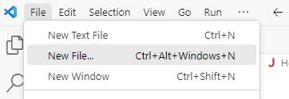
Code Editor
Step 1: Create a file.

Slide 34
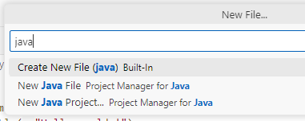
Code Editor
Step 2: Create New File (java) Build-in

Slide 35
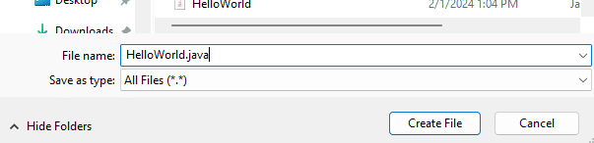
Code Editor
Step 4: Name of your class (Capital letter and no space in the name)

Slide 36
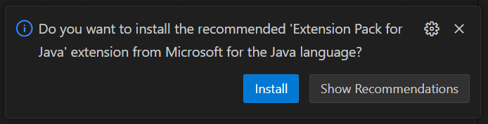
Code Editor
Step 5: When you create a .java file for the first time, the editor will offer to install the Extension pack for Java.

Slide 37
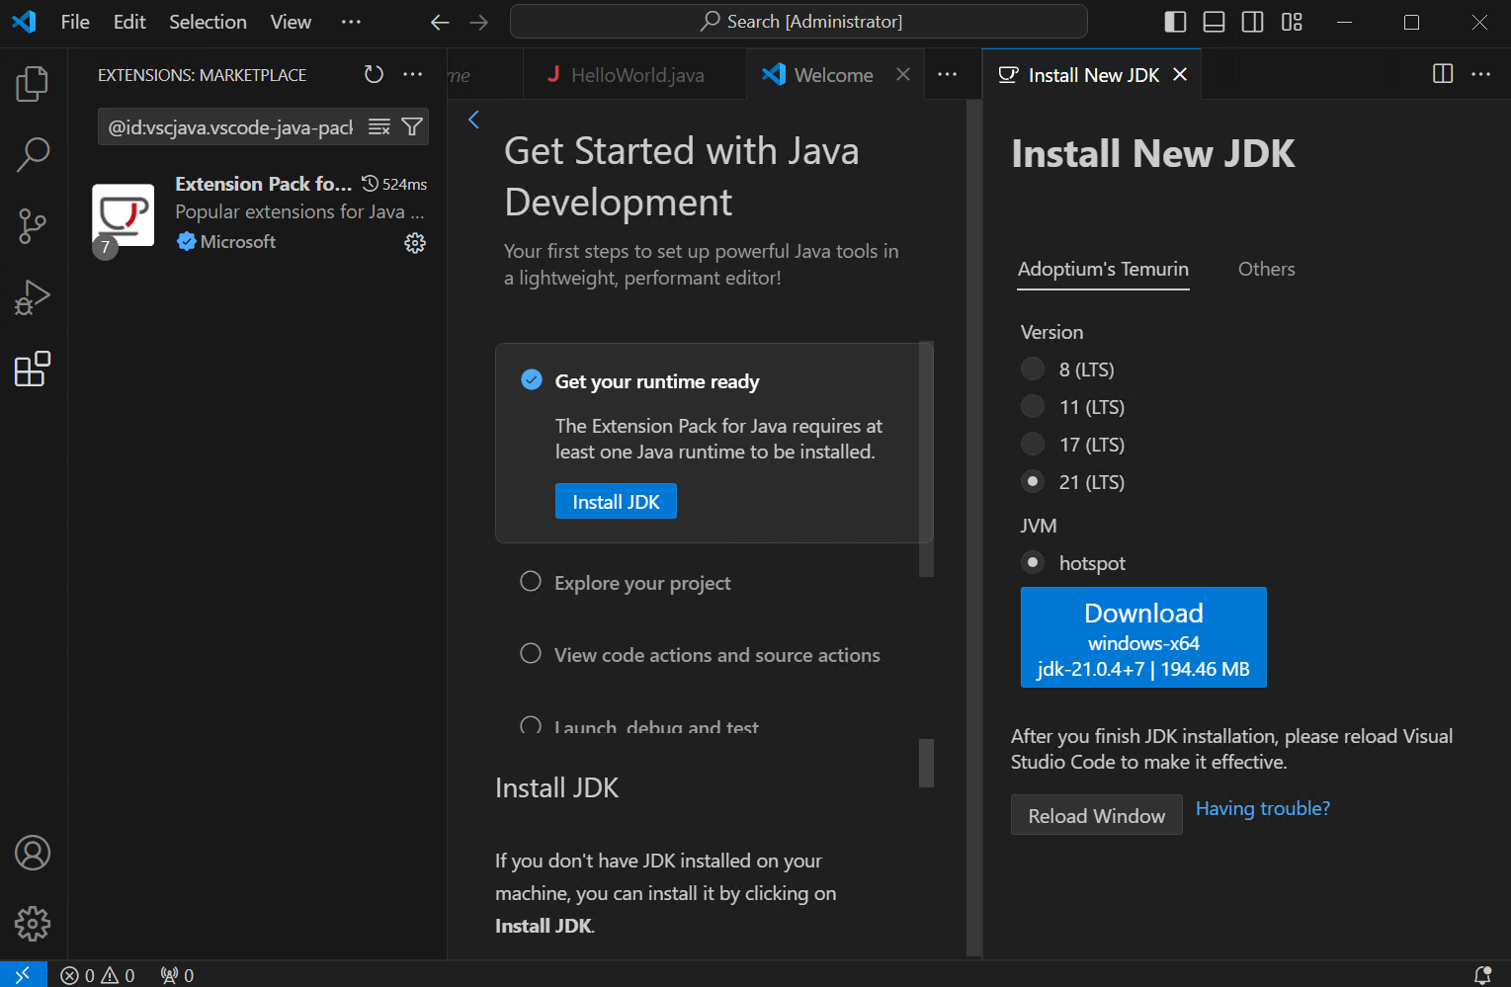
Code Editor
Step 6: When it finishes installing the extension, the editor will ask you to install the Java Development Kit (JDK)

Slide 38
public class HelloWorld {
public static void main(String[] args){
System.out.println("Hello World !");
}
}

Slide 39
Code Editor
Open and run an existing program

Slide 40
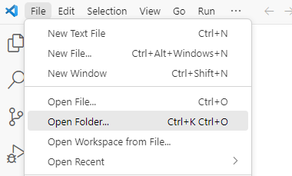
Code Editor
Step 1: Open the main folder.
It will be your working area.

Slide 41
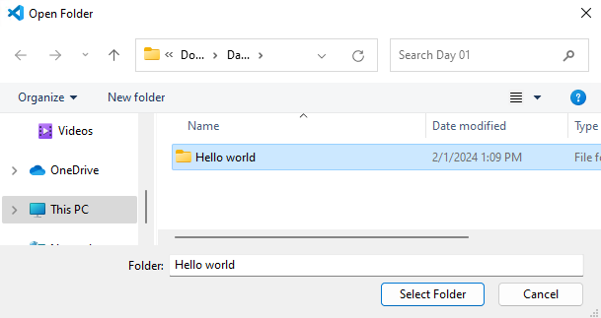
Code Editor
Step 2: Choose the main folder.
It will be your working area.

Slide 42
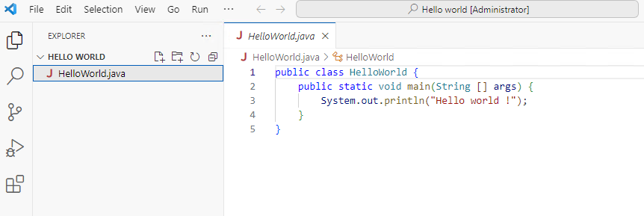
Code Editor
Step 1: Create/Open the main folder.
It will be your working area.

Slide 43
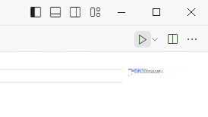
Code Editor
Step 3: Run the program

Slide 44
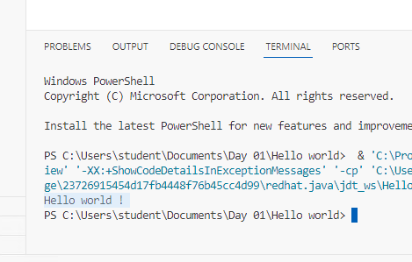
Code Editor
Step 4: See the output

Slide 45
Variables
A variable is a data container.
It can contain 1 information per time.
int age = 30;

Slide 46
Variables
data_type name = value ;

Slide 47
Variables
Start with letter or _underscore
Unique word in the code
No special symbols
No Java keyword

Slide 48
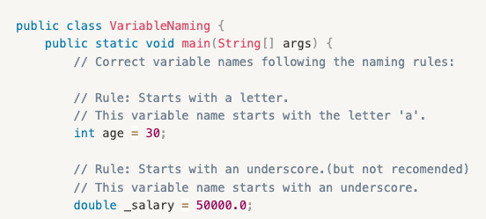
Variables

Slide 49
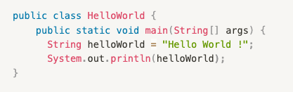
Variables
Use variable value

Slide 50
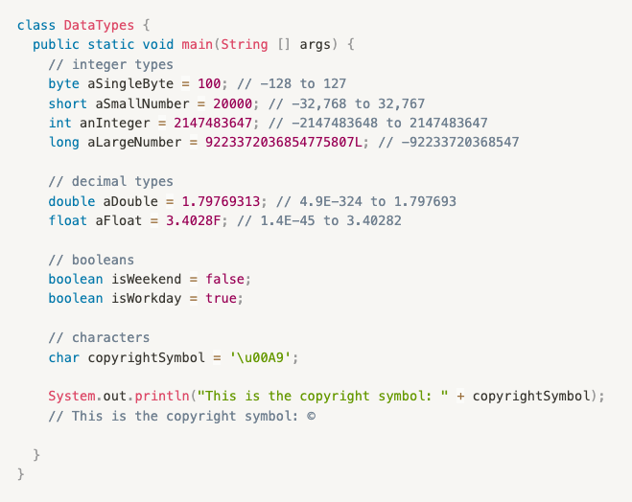
Data Type

Slide 51
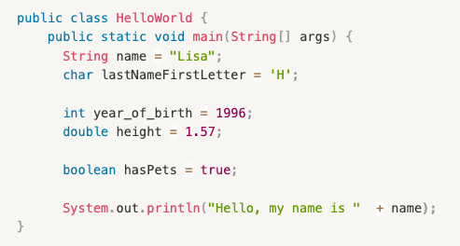
Let’s start with simple data types

Slide 52
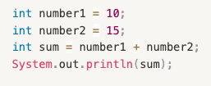
Operations
You can also do simple mathematical operations, like this:

Slide 53
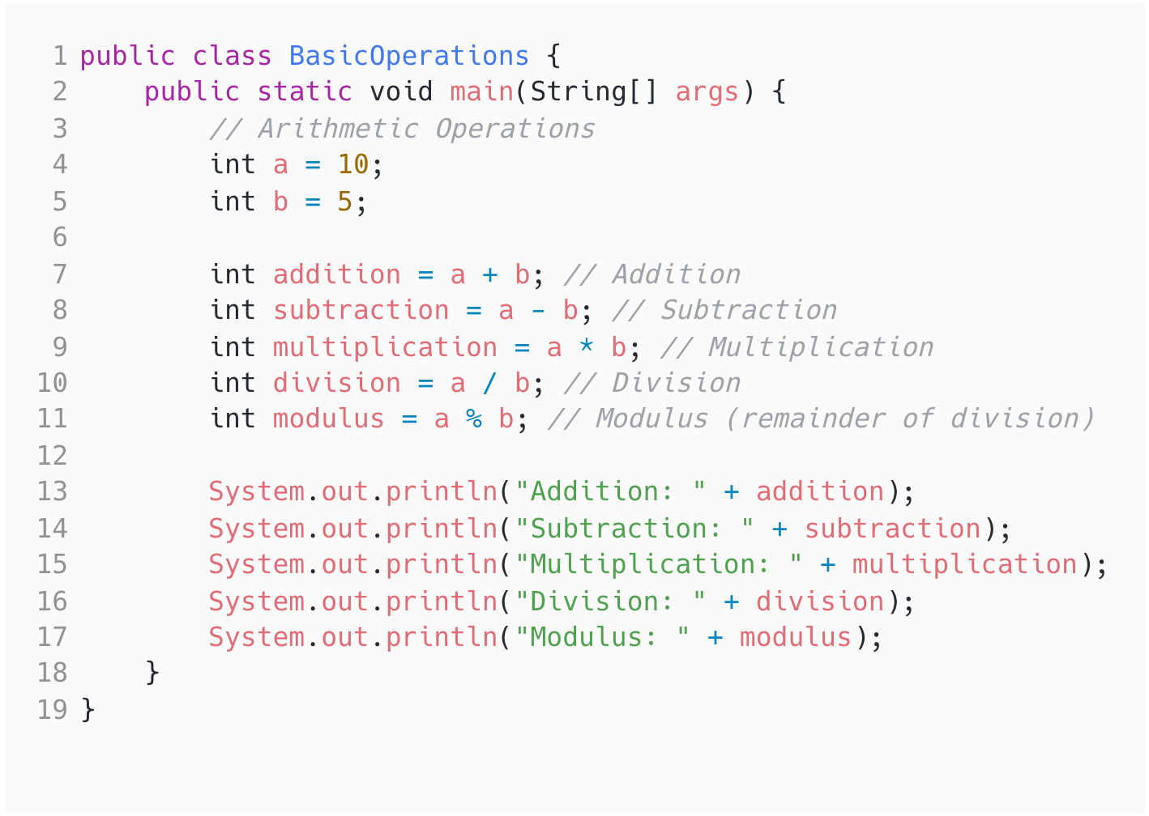
Operations

Slide 54
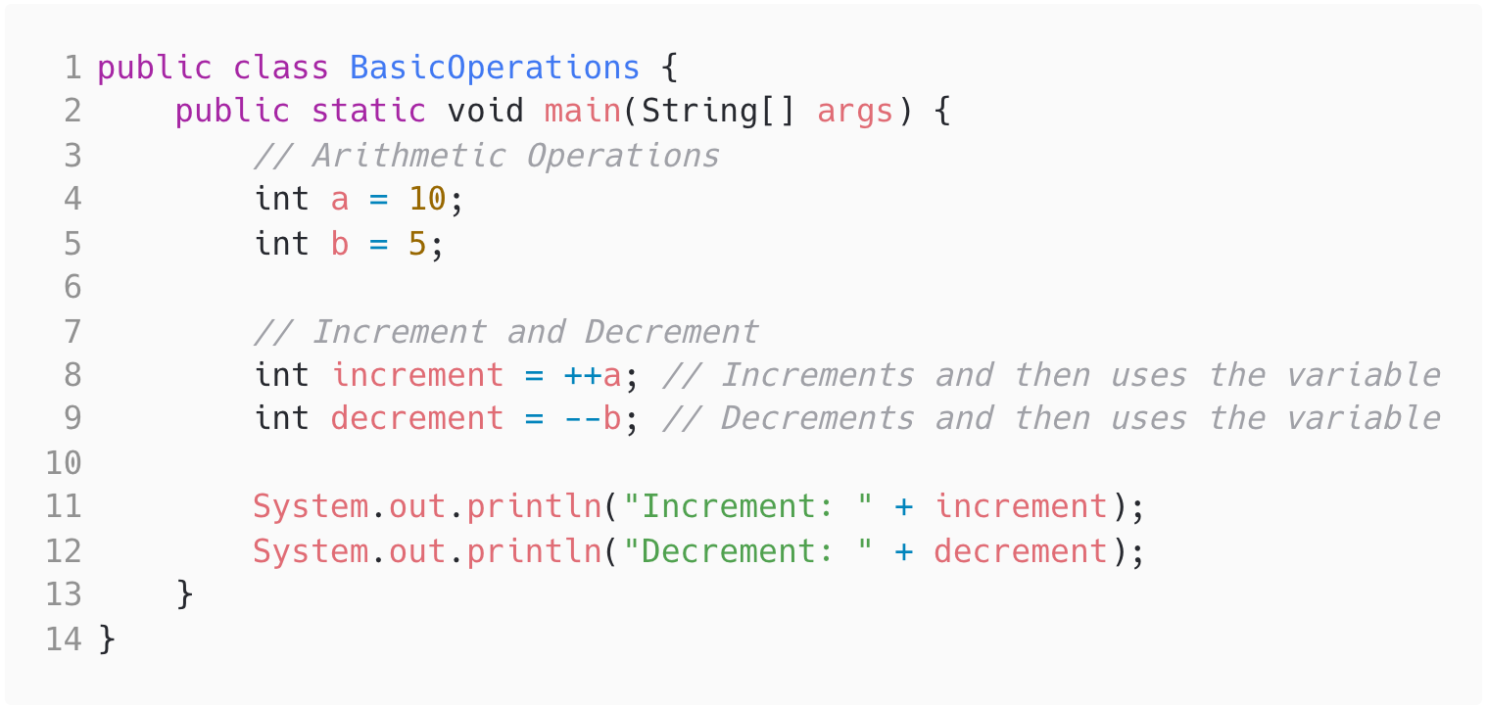
Operations

Slide 55
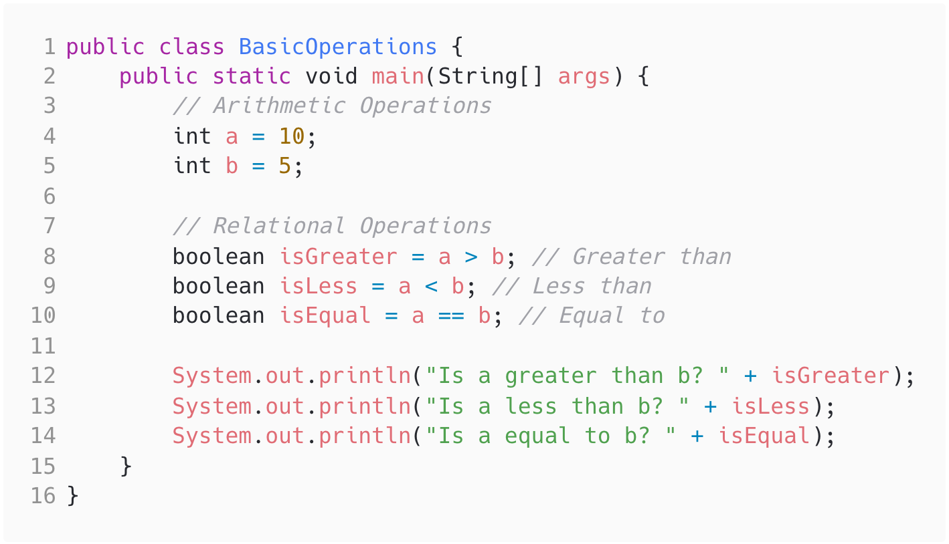
Operations

Slide 56
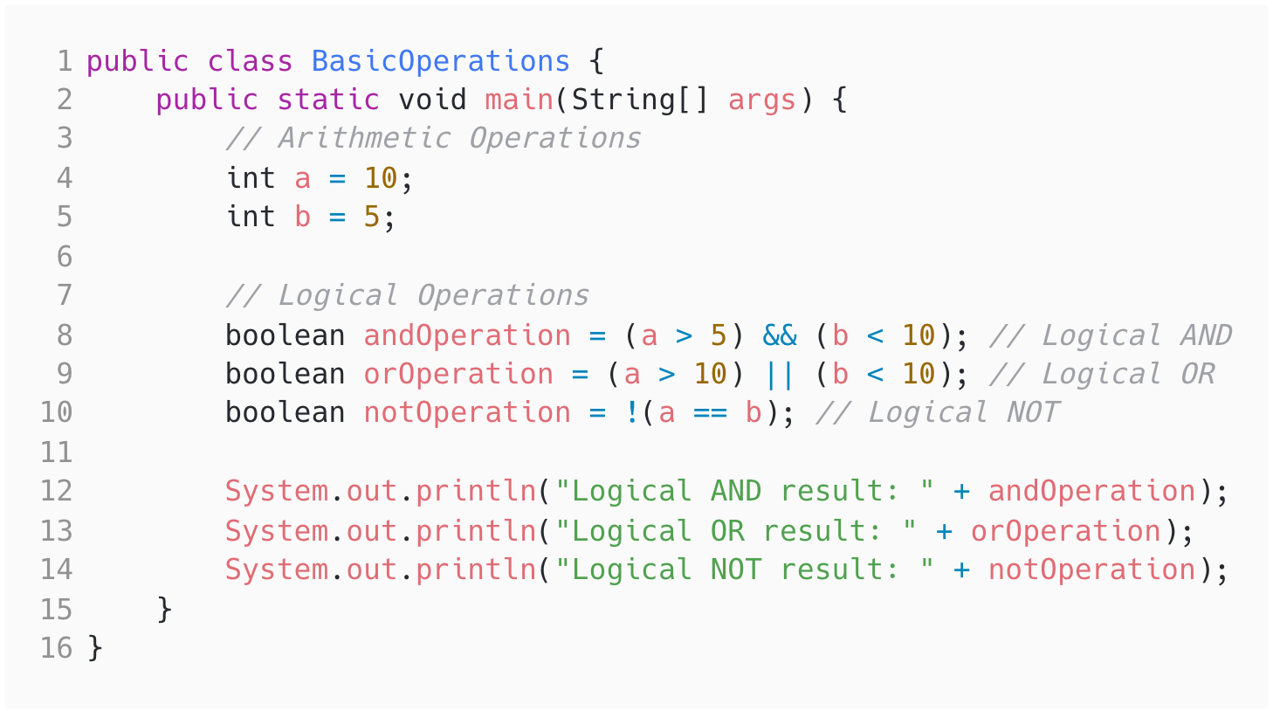
Operations

Slide 57
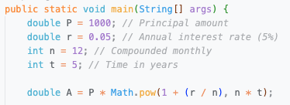
Operations
Math library
Predefined constants (PI)
Functions (exponential, power, etc)
Utility methods (round, random, etc)

Slide 58
Now YOUR TURN !
Let’s do exercises number 2

Slide 59
Input
Input is the process of providing data or information to a computer program during its execution.

Slide 60
Input
To obtain an input in java, you need a special “tool” called Scanner that can recognize the entered data.

Slide 61
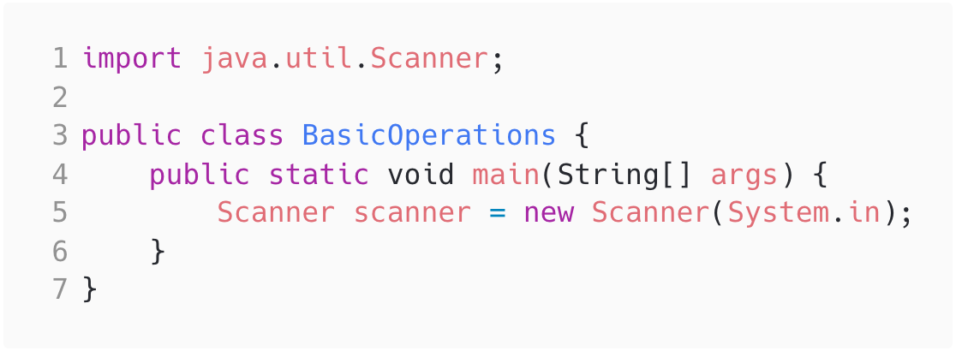
Input

Slide 62
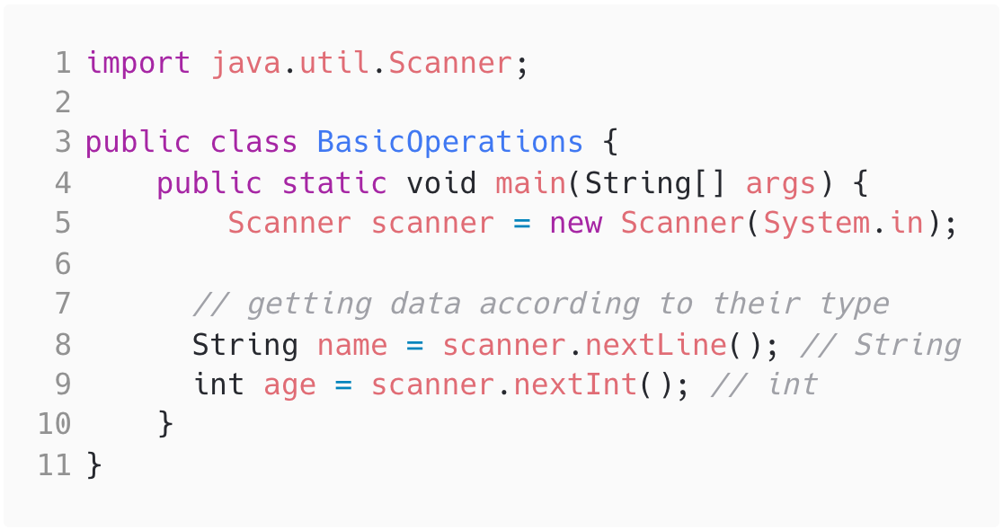
Input

Slide 63
Now YOUR TURN !
Let’s do exercises number 3

Slide 64
Project Students - Step 1
Your program should store the following pieces of information for a student:
First Name - String
Last Name - String
Birthday (Day of the Month) - int
Birth Month - int
Birth Year - int
Course Registered - String

Slide 65
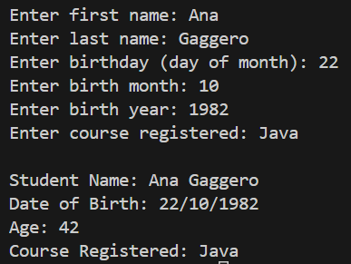
Project Students - Step 1
The program should print the requested information plus the student's age.
For now, we don’t take
month and day into
account for the calculation.
To get the current year:
Output:
LocalDate today = LocalDate.now();
int currentYear = today.getYear();

Slide 66
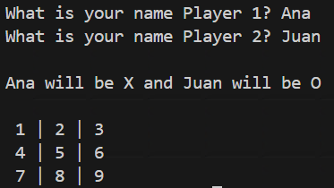
Project Tic Tac Toe - Step 1
Ask the names of both players
Print the board before the first move

